Slide 1
WARGAME
RULES

Slide 2
Rules Quick guide
ISR | Fires | Protection | Combat
Satellite Sweep. Uses optics, radar and EW to detect enemy activity in 50x50km area. Sees only Company and above. Role 5 or above to reveal all enemy units in NAI. Cyber exploitation. Uses enemy soldiers use of social media etc to locate approximately position of battalions and above. Role 4 and above to reveal all battalions in 100x100km area. Place large marker. Role 6 to reveal DIV and Bde HQ’s Arial observation. Uses optics, EW and radar to detect battalions in a 50x50km area. Role 4 and above to reveal battalions. Place large marker. Recce units. units can observe adjacent HEX Units in adjacent HEX are always detected by all unit types Recce units can move out of contact with no penalty Hidden OP’s. Each Recce platoon can deploy 1. OP. An OP observed adjacent HEX. It cannot move and cannot be found. It is automatically killed by fires in the HEX it occupies. UAS. Can observe according to unit marker and card. Role a dice pr HEX Role 4 or above to detect units in the NAI/TAI. Role 6 to detect units among in- and exfil route EW. Can observe units within its cone. Role 3 or above to detect HQ and fires units. Role 4 or above to detect companies Role 5 or above to detect platoons EW does not see unit type, but enemy activity. EW does not reveal it’s position when scanning. Radar. Can locate any fires, Air or ground unit in its cone dependent on radar type. Role 3 or greater to observe. Does not see unit type, but enemy activity. Radar reveals it’s position when scanning/active. Radar is blocked by towns and forrest. Unmanned Ground Sensors. Any company can lay an unmanned ground sensor. It takes one action to do so. The sensor detects any unit that passes on it. Does not see unit type but activity Unit type or activity. Recce units and UAS are able to detect and specify type of enemy. Place right marker on common map. EW, Radar and unmanned Ground Sensors detect activity but not which type of unit occupy the HEX. Place colored marker on common map. Detection. Add or subtract the detection modifier to any ISR platform if concealled. | Air support. Players can be supported by 3rd generation (F-16) or 5th generation (F35) airframes. Each sortie deliveres 2 PGM bombs with +1 multipliers 3 Gen deliver weapons 7km from the target from a pre designede azimut. 5 Gen deliver weapons 20km away from the target from a pre-designated azimut. 5 Gen makes an automatic optical, EW and Radar sensor sweep of 50x50km area centered around bombing target. Role 4 and above to see all enemy units. Cyber. Cyber effects enemy Command and control networks Cyber Network Attack: Role 6 to disable all enemy JTF and Corps ISR and fires. (cuts connection to higher HQ) Disabled units are marked with Cyber Marker Info. Info effects Command and control, troop moral or civilian actions. Player decide target audience. Role 6 to cancel enemy ISR and Fires efforts for two turns Role 6 to make all ONE LEFT platoon flee Role 6 to have civilians flee and place civilian crowd on MSR leading away from fighting (enemy rear) Disabled units are marked with INFO Marker Ballistic missiles. 1 ATACMS or ISKANDER-M strike. Throw 3 dice with +2 modifier on any target on map. Mortars, Artillery and rockets. Role a dice pr platoon as in fighting. Include attack, Armor and terrain multipliers. Loses only incur on target unit. Several artillery units can fire at the same target adding dice for every platoon. Fires units reveal themselves on the shared map when firing. EW. Jamming effects enemy command and control on battalion and above levels. Role 4 or greater to hinder ISR and Fires for one turn for effected units within EW cone of effect. Effected units is marked by EW jamming marker EW unit is revealed when jamming. | Air Defense. When an airframe comes within an air defense units range the platform is detected and the air defense unit gets the choice to fire once pr platform. One die role for attack and defense. The air defense gets to shoot before aircraft can conduct ISR mission but after weapons drop. Air defence unit is revealed when shooting. Counter battery fire. If a player has a designated artillery unit and an Weapon Locating Radar assigned it gets 1. opportunitet to conduct counter battery fire after the other players fires unit has fires once. | Fight: When a unit is within the range of an enemy unit the player can choose to engage the enemy. The unit uses one action pr engagement. One hex is played at a time. The player roles one dice pr platoon in the hex adding attack multiplier from the unit marker and any terrain or other multipliers to the dice role. The enemy roles a dice for every platoon in the target hex, adding armor multipliers from the unit marker and any terrain and other multipliers to the dice role. The dices are compared. The highest dice role wins and the looser looses one platoon pr lost dice role. Either side can have more dice than the other increasing the chance of success. (highest dice is compared to highest) In case of a tie no one wins. When a platoon is lost the marker is turned. If the marker is already turned the looser roles a dice to check if the remaining platoon flees the battlefield. Role a 5 or more to stay. If the role succeeds a ‘one Left’ marker is put on the unit marker. The remaining platoon must make a ‘Flee’ check every turn it is engaged. When a Platoon marker is destroyed it is removed. Concealment and camouflage. A unit can use an action point to hide from the enemy. This can only be done if the unit has not been revealed in that location before. When a unit is concealed a concealment marker is placed on it. The unit is concealed until it moves. The unit has a +1 modifier on detection by any enemy ISR means – not combat units.
 |  | Combat
 |  | General: All units have 3 actions during one turn. Any unit can either Move, Fight, conduct fires/other effects (if the unit has this capability) or conceal itself. The order is up to the player. When the unit has conducted an action the marker is turned 90 degrees right in order to keep track. Movement: All units can move according to the unit markers 4th number. That number is the absolute number of moved that turn. Movement on road takes 1 movement point Movement in open terrain takes 2 movement points Movement in swamps and forests takes 3 points See Terrain Effects on other side. A unit in contact can disengage only after a fight. A recce unit can disengage without fighting When a unit moves within range of an enemy direct fire unit, the enemy unit gets to fire a free fire attack.
Version 1.4
Concealled

Slide 3
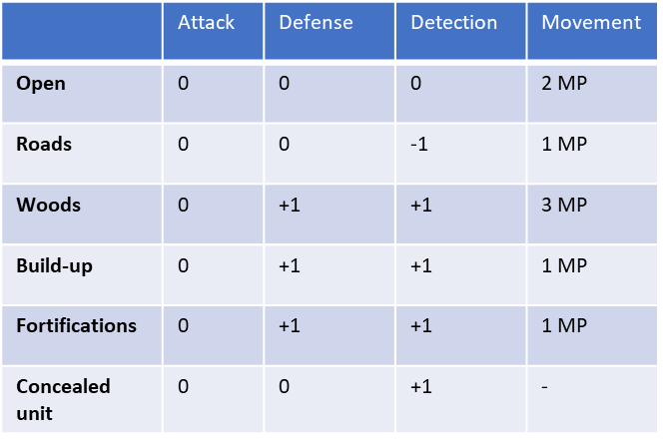
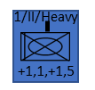
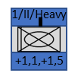
Rules Quick guide
Engineer works | Logistics | C2
Minefields Mine fields: A combat engineer company can build a 1 HEX minefield in a turn. It takes all three actions. If disturbed it starts over. Combat engineer companies carry mines for one minefield. Put a Mine field marker on the Hex when layed. Breaching mine fields: A combat engineer company can breach a minefield. To make a lane through a minefield (any direction) the Combat Engineer company move on the minefield. It takes 2 actions to clear the field Role 2 or more to clear successful without losses. The company can only defend itself when clearing. Remove minefield marker when it is cleared Any unit sees a mine field when it is on it A unit crossing an uncleared minefield roles a dice pr platoon to tjeck for losses. Role 4 or more to get across without losses. Bridges Crossing rivers: A Combat Engineer Company with an armored bridge can bridge a small stream in on action. It cannot do this under fire. A Construction Engineer company can build a follow-on bridge in three actions. When bridging place the company on the crossing site. Place the armored bridge on the hex. Destroying bridges: A bridge marked on the map can be destroyed by a Combat Engineer company in two actions. Place marker when destroyed Fortifications Company fighting positions: A Combat Engineer Company ban build a fortified company position in three actions. Place the company on the position when building. A fortification cannot be build under fire. Place fortification marker on hex when build A company fighting from a fortified position gets +1 in defence. And +1 on detection It is possible to build fortifications in build-up-areas and forests | Supply Companies that has taken casualties can move to a Brigade supply area and resupply one platoon pr two turns. One turn is 6 hours. 4 turns is a day of battle. Time is kept by a designated player, visible for all. All companies carry 2 days of supply All Battalions carry 3 additional days of supply All Brigades carry 4 days of supply Transport companies can either deliver or pick up one day of supply. When a Battalion is resupplied so is the companies and platoons. If a company runs out of supplies, it can’t move or fight Resupply When a Battalion as a whole is more than 20 Km from the closest enemy unit it can travel as a unit occupying a 7 Hex cluster. It can move the double distance of the slowest subunit. Stationary battalions more than 20Km away from enemy can be assembled to a 7 Hex Cluster Clustered battalions can be targeted. | Rules surrounding command and control: NATO units use maneuver warfare and mission command. Forward Command posts (FCP), Operations centers (OPS) and Plan centers (PLANS) are the tools for planning and coordination of fire, maneuver, ISR, Logistics etc. If a command installation is destroyed the units below can move and operate with own means but cannot draw on fire or other support for the command installation or higher headquarters for a round. Russian units uses Fires centric warfare and orders command. If a command installation is destroyed the subunits under that command installation can only defend itself if attacked for a round.
 |  | Terrain effects
7 HEX Cluster
Unit marker
Attack multiplier
Effects markers
Weapon range
Armor multiplier
Movement point
Marker indicating only one platoon left
Unit marker lost one platoon

